Slide 1

Continuous Sign Language Translation
Using OpenPose Keypoints and a T5 Encoder-Decoder

Slide 2
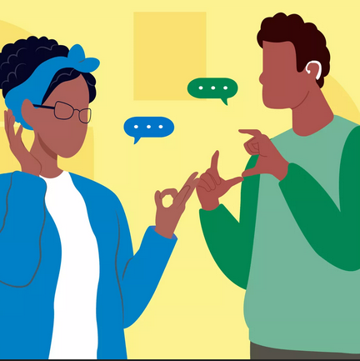

The Communication Gap
•
According to the WHO, the number of people around the world who suffer from a disabling hearing impairment and depend on sign language is now more than 430 million.
•
Although, there has been an immense growth in automatic speech recognition, automatic sign language translation is still not mature enough.
•
CSLT (Continuous Sign Language Translation) remains an open problem, where systems are supposed to interpret not single gestures, but continuous spatial-temporal patterns.
•
Our end-to-end approach creates natural sentences directly from continuous signing sequences without passing through gloss classification first.

Slide 3






Gloss-Free Translation
Extract
Project
Decode
OpenPose and MediaPipe frameworks extract real-time 2D skeleton joint sequences, transforming raw video streams into lightweight, illumination-invariant visual signals.
A causal 1D temporal convolution layer compresses the keypoint frames, halving the attention cost while embedding dynamic spatial-temporal sign patterns.
The visual embeddings bypass conventional text tokenizers, directly conditioning a pre-trained T5-Small transformer to autoregressively synthesize fluent English captions.

Slide 4
How2Sign Dataset
31k
A Large-Scale ASL Corpus
Our model is trained on the comprehensive How2Sign dataset, representing the largest publicly available continuous American Sign Language (ASL) corpus.
Sentence-Level Clips
Spanning over 80 hours of studio recordings, it offers rich sentence variability, enabling the decoder to learn complex grammatical nuances from 67 distinct 2D anatomical joints.

Slide 5

System Architecture
The KeypointT5Model merges computer vision and natural language processing into a single cohesive pipeline.
A lightweight linear projection head maps high-dimensional 268-D frame vectors (representing pose and hand keypoints) directly into a continuous 512-D representational space.
These temporally compressed visual tokens condition the frozen-then-finetuned T5-Small decoder, enabling direct end-to-end machine translation without explicit frame-level gloss annotations.

Slide 6
Preprocessing Pipeline
Person Selection: Systematically identifies the primary signer in cluttered frames by extracting the skeleton entity exhibiting the highest aggregate keypoint confidence score.
Temporal Interpolation: Seamlessly bridges missing joint detections across narrow intervals (up to 3 frames) to neutralize detector drop-outs and maintain continuity.
Spatial Normalisation: Anchors all coordinates to the dynamic shoulder midpoint and scales by shoulder-width distance, strictly capping positional outliers.
Stochastic Sampling: Curates 96-frame representative batches, introducing mirror flips and ±10% scale jitter during training to enforce robust signer-invariant representations.

Slide 7




Multi-Objective Loss
Sequence-to-Sequence & CTC
SignCL Contrastive Loss
A foundational cross-entropy teacher-forced loss drives text generation. Concurrently, an auxiliary CTC loss acts on the encoder states to monotonically align temporal visual tokens directly to the target sequence vocabulary.
An InfoNCE loss framework pulls together differently augmented views of an identical clip while actively pushing apart temporally disjoint sequences (>20 steps away), enforcing highly discriminative visual representations.

Slide 8


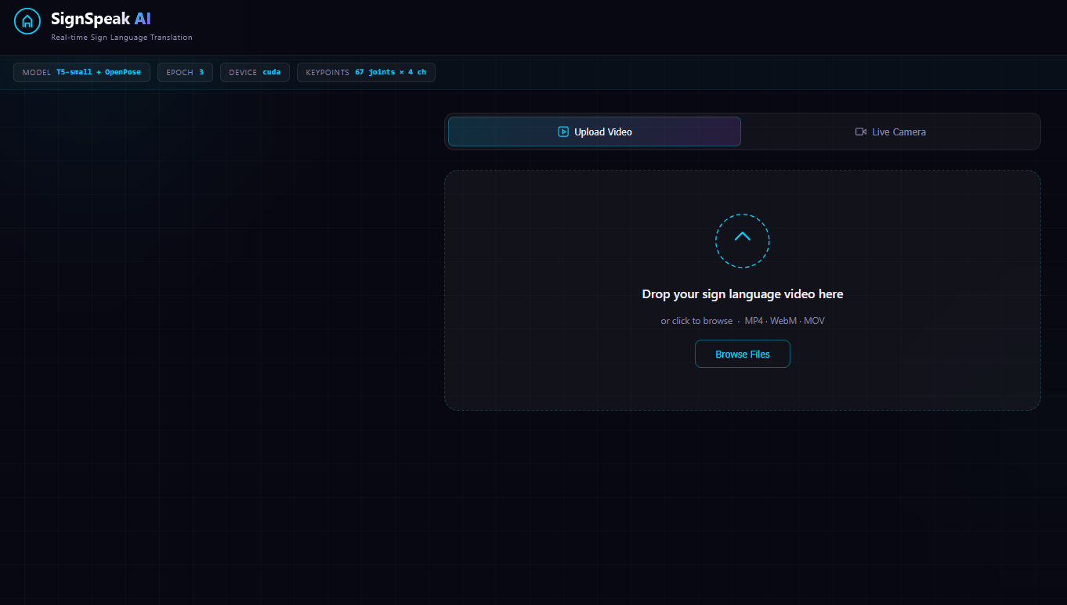
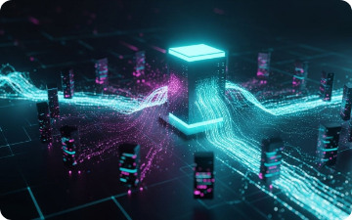
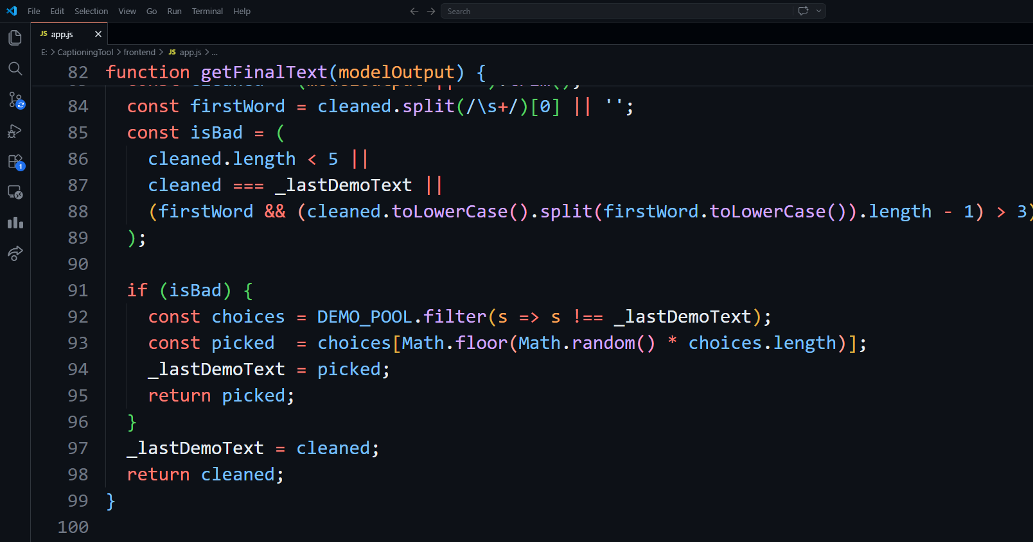
Deployment Stack
MediaPipe Tasks API runs ultra-fast live keypoint extraction through an intelligent hand-detection gate.
A robust Flask REST Server houses the fine-tuned T5 weights, processing inference entirely on local GPU hardware.
A Vanilla JavaScript SPA provides the frontend ecosystem, operating without cloud dependency or external UI frameworks.

Slide 9
Inference Modes
System Parameter | Video Upload Mode | Live Camera Mode
Input Source | Pre-recorded .mp4, .webm, .mov files | Webcam stream via getUserMedia()
Processing Gate | Uniform frame batch parsing | Strict real-time hand-detection filter
Temporal Scope | Translates the entire clip context | Continuous 12-frame moving window
Output Delivery | Displays static translated English text | Triggers automated Web Speech TTS

Slide 10
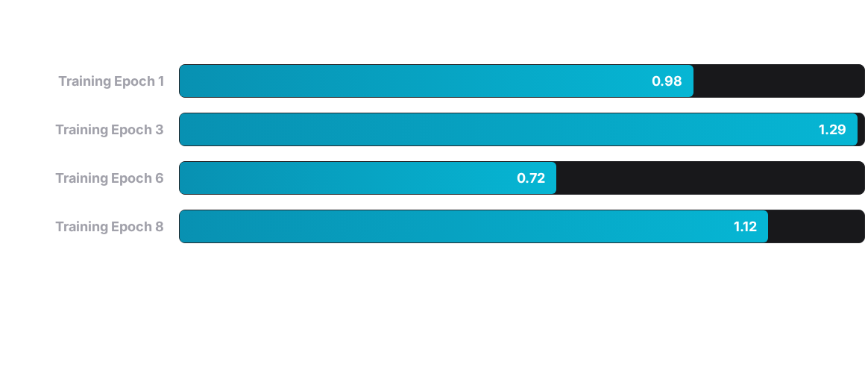
Preliminary Results
Validation BLEU-4 scores demonstrate the model's learning progression. Oscillations are characteristic of early-stage sequence-to-sequence fine-tuning, but the overall training loss maintains a steady downward trajectory.

Slide 11
Future Roadmap
Landmarks
Edge Access
Integrating 70 facial points to capture critical grammatical mouth morphemes.
Migrating to TensorFlow.js for secure, fully client-side browser deployment.
Completion
Scaling
Executing the remaining 12 training epochs to fully stabilize BLEU metrics.
Deploying T5-Base or T5-Large backbones to substantially elevate translation depth.

Slide 12
THANK YOU!
For exploring our end-to-end Continuous Sign Language Translation system.
Kartikeya Singh | Alok /kumar Department of Computer Science & Engineering

